Slide 1


CHATBOT SONG RECOMMENDATION SYSTEM
Prestige Institute of Engineering Management & Research , Indore
Department of Artificial Intelligence and Data Science

Slide 2


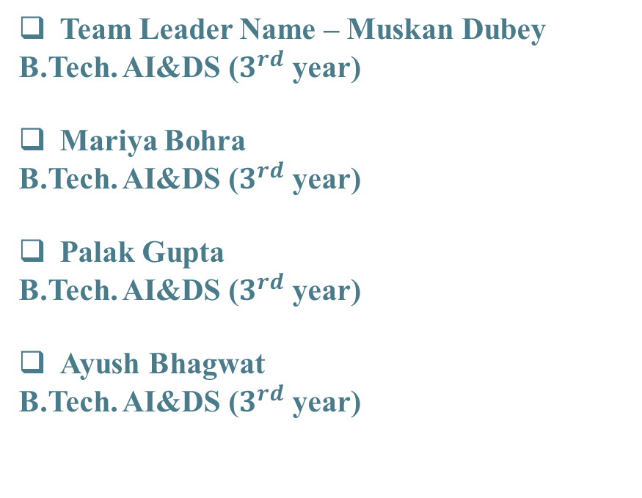
Team members
Team Leader Name – Muskan Dubey
B.Tech. AI&DS ($3^{rd}$ year)
Mariya Bohra
B.Tech. AI&DS ($3^{rd}$ year)
Palak Gupta
B.Tech. AI&DS ($3^{rd}$ year)
Ayush Bhagwat
B.Tech. AI&DS ($3^{rd}$ year)
Team Mentor Name – Dr. Naveen R. Shahi
Department – Artificial Intelligence & Data Science

Slide 3

Project Outline
Introduction
Primary goals
Product Architecture
Application
Project status

Slide 4
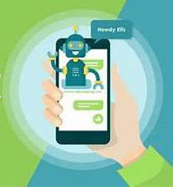
Introduction
One area which has been gaining momentum is the use of chatbots for music recommendation. Such systems utilize AI technologies to deliver personalized music recommendations to users via conversational interfaces.
Gone are the days of aimlessly searching for the right song or relying on generic playlists that fail to capture your mood.

Slide 5

Primary goals

Slide 6
Primary goals
Develop algorithms that can understand users' musical preferences through natural language interactions, previous listening history, and feedback to provide highly personalized song recommendations tailored to each user's unique taste.
Ensure that the recommendations provided by the chat bot are accurate and relevant, taking into account various factors such as genre preferences, mood, tempo, and context of the user's request.
Curate a diverse range of music recommendations to cater to users with different musical tastes and preferences, ensuring that the recommendations reflect a broad spectrum of genres, artists, and cultures.

Slide 7

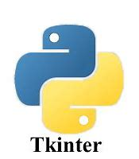

Technology used
Python allowed developers to express programming concepts using fewer lines of code and in a much more intuitive way. This was pretty revolutionary. And so, while Python was first intended for writing basic scripts, it soon grew in popularity. And in the digital age, it has boomed.
The tkinter package (“Tk interface”) is the standard Python interface to the Tcl/Tk GUI toolkit. Both Tk and tkinter are available on most Unix platforms, including macOS, as well as on Windows systems.

Slide 8
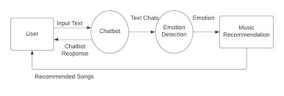
Product Architecture

Slide 9

> Music Streaming Platforms > Collaborative Playlists > Mood-Based Recommendations
Applications
Song recommender systems find applications in various domains, enhancing music discovery and user experience:

Slide 10
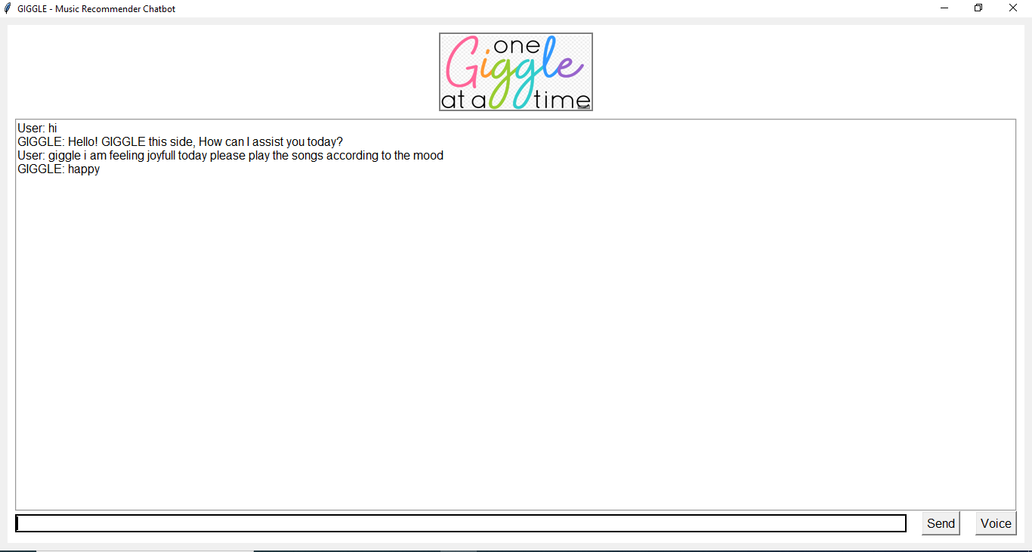
Project Status

Slide 11

Summary
Chatbot Song recommendation system provides the personalized music recommendations based on their mood.

Slide 12


Thank you

